Slide 1
Smart home
Software simulation

Slide 2
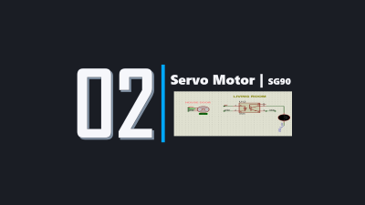
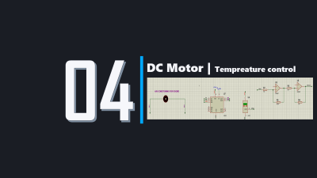

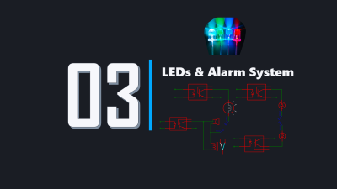
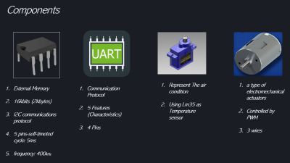

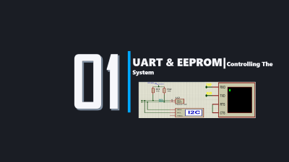




INTRO
LED
Presentation content
UART
DC
SERVO
LCD

Slide 3
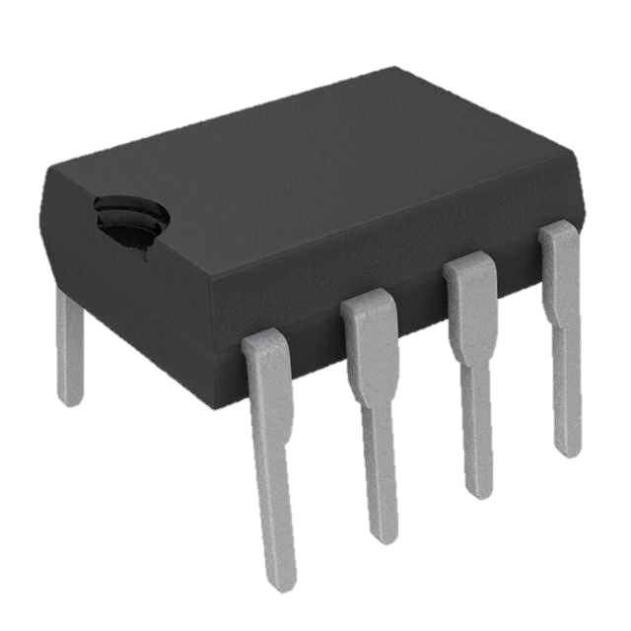

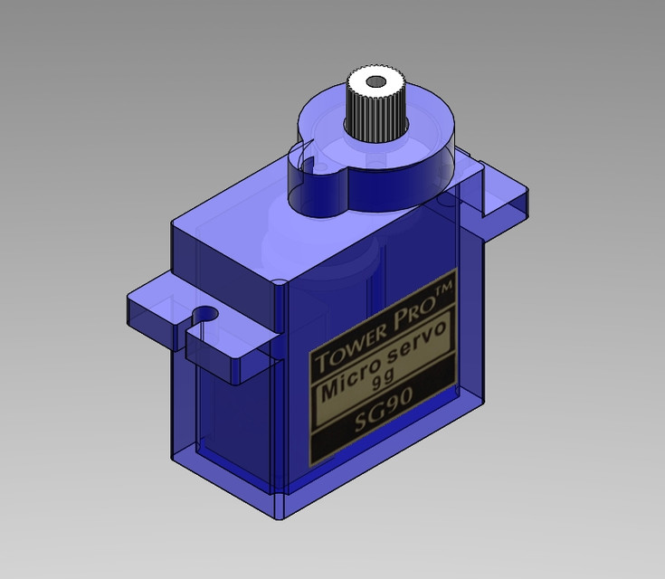

Components
Represent The air condition
Using Lm35 as Temperature sensor
a type of electromechanical actuators
Controlled by PWM
3 wires
External Memory
16kbits (2kbytes)
I2C communications protocol
5 pins-self-timeted cycle: 5ms
frequency: 400kHz
Communication Protocol
5 Features (Characteristics)
4 Pins

Slide 4
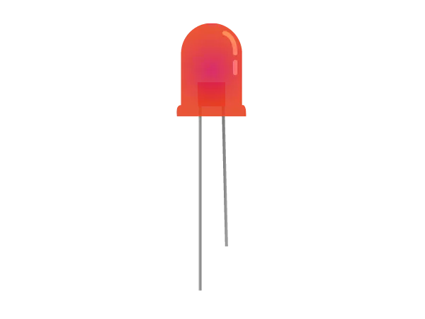
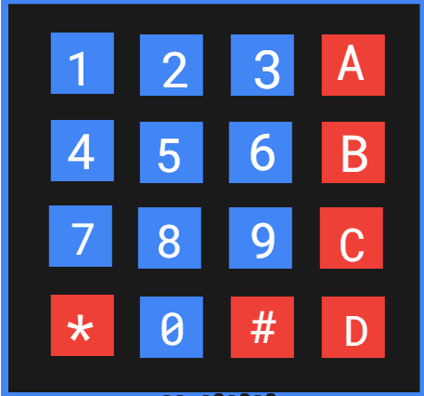
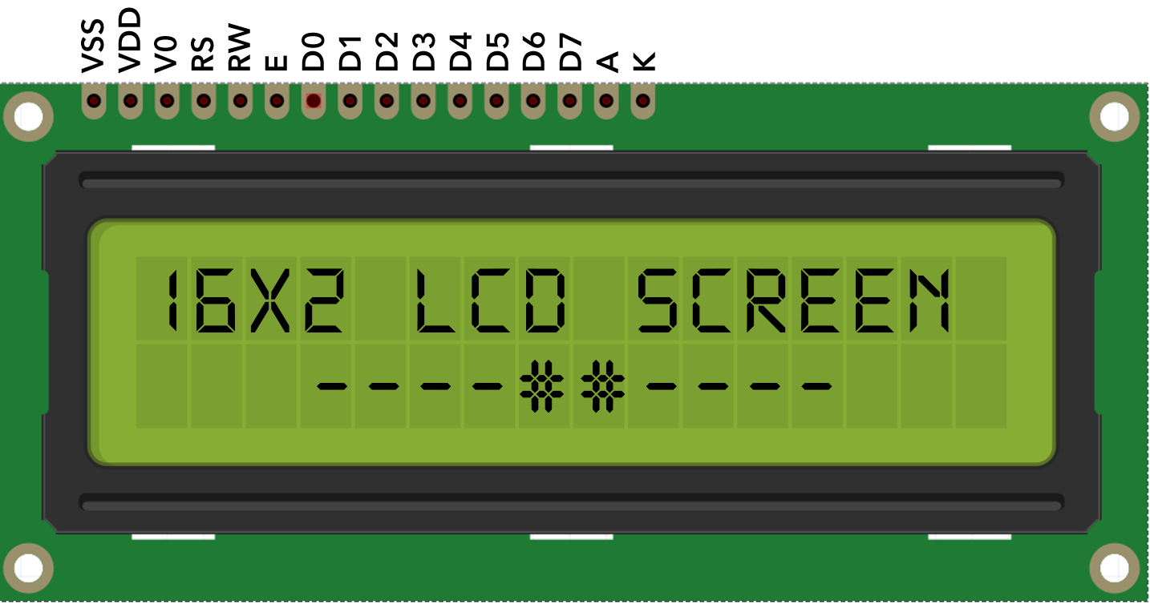
Components
Each room has a LED as a source of light
Used in the alarm system
The alarm system protect the house from unauthorized person to access it by lighting the LEDs , Buzzer, etc…
electronic display module
Has 13 pins
can display 32 ASCII characters in two rows of 16 characters each Each of these rectangles is a grid of 5×8 pixels
Has two modes
have EIGHT TERMINALS. four are ROWS of MATRIX and four are COLUMNS of MATRIX.
These 8 PINS are driven out from 16 buttons present in the MODULE.

Slide 5
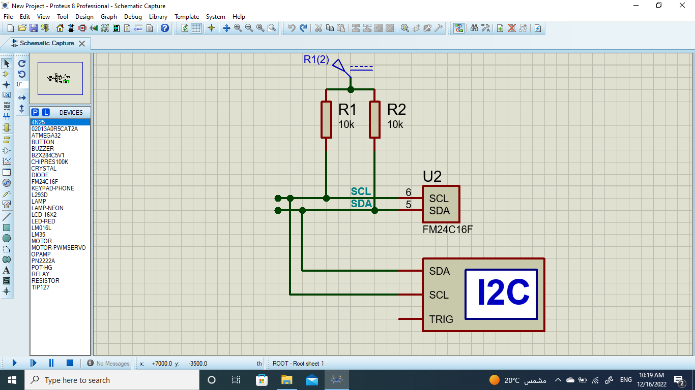
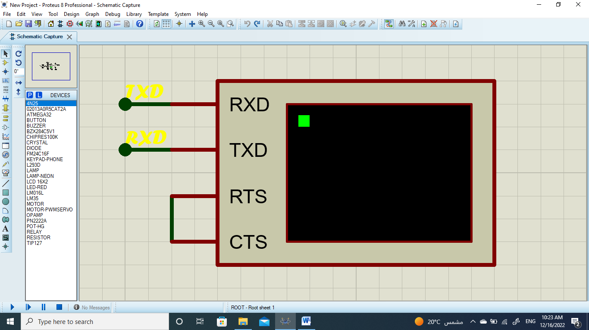
01
UART & EEPROM|Controlling The System

Slide 6


UART & EEPROM| Function
UART
Used to communicate with the microcontroller
Used as a main access to the system (Admin & User)
EEPROM
Used to store the username & passwords of admins and users
Used to store the crictial variables in the project

Slide 7
UART & EEPROM| problems
UART
How to make it the first priority for the system.
The complicated connection with emergency case system.
EEPROM
Searching for the Alternative to AT24C16A in Proteus.
How to add and delete Admin/User.

Slide 8

UART & EEPROM| problem solving
UART
Using UART receive interrupt
Using Key-Variables that make it easier to link
EEPROM
Using Google & You-tube to search for Alternative and by trying many options
Using Linked List method concept

Slide 9
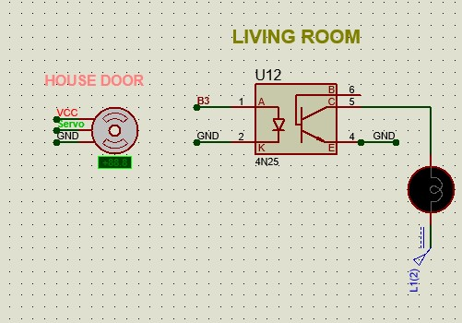
02
Servo Motor | SG90

Slide 10
Servo Motor | Function
To control the door
Openning the door by +90 deg
Close the door by return to 0 deg

Slide 11
Servo Motor | problems
Clock frequency
Duty cycle value
3. ICR1A value

Slide 12
Servo Motor | problem solving
Using 16MHz as external clock so the timer will get 250kHz
Choose suitable value for ICR1A that gives period of 20ms (50Hz)
3. Choose suitable values for OCR1A

Slide 13
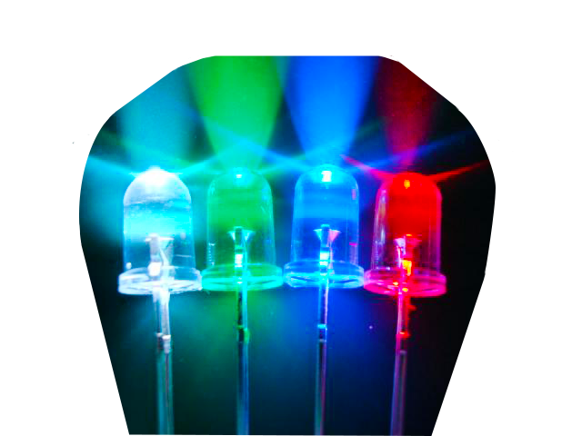
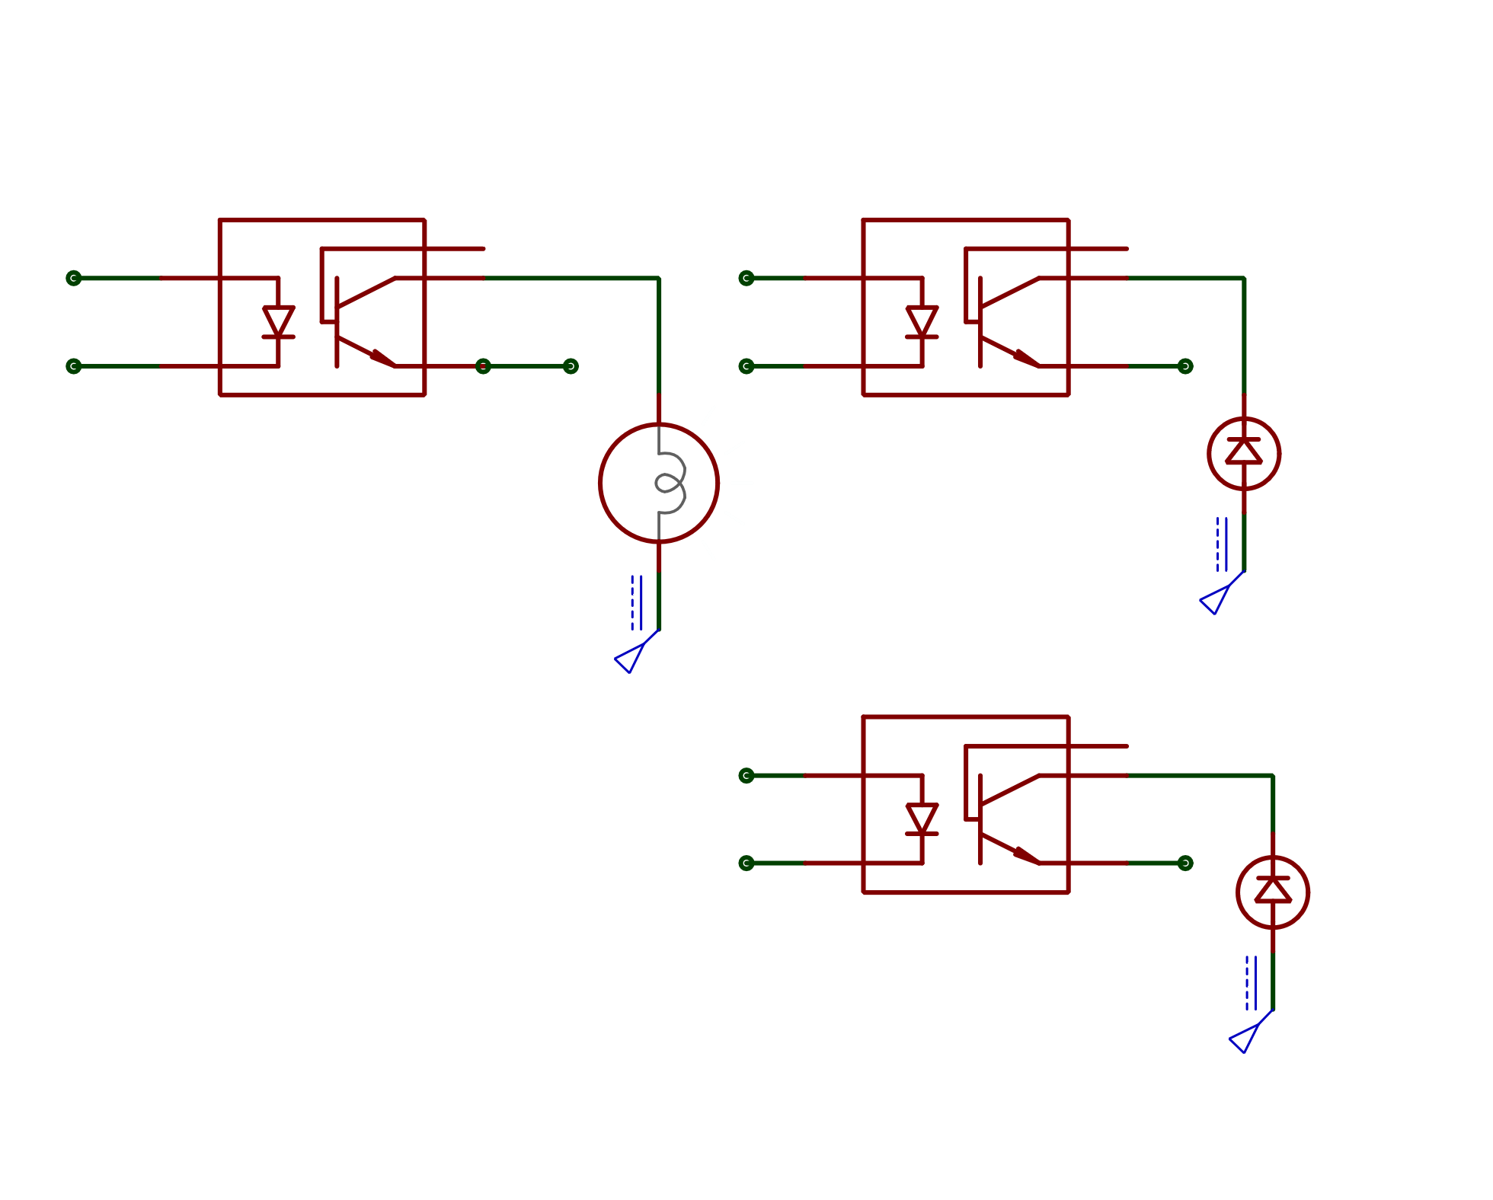
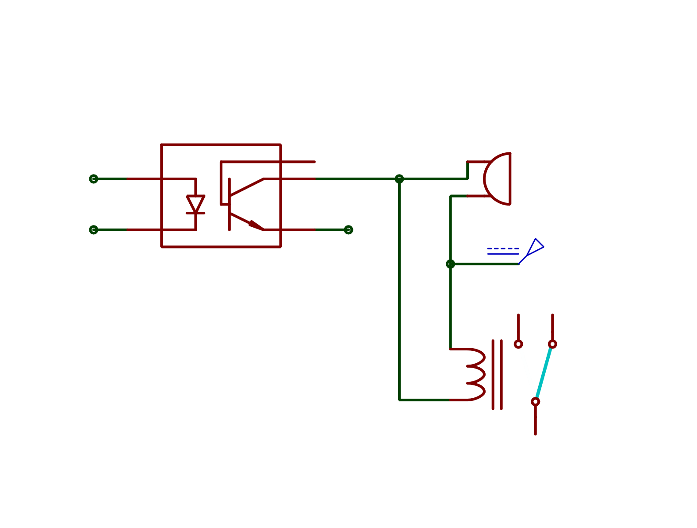
03
LEDs & Alarm System

Slide 14
LEDs & Alarm System | Function
LEDs are used to light each room separately ( 5 LEDs are independent )
Dimmer lamp with adjustable brightness which the user can control.
The Alarm System fires when a suspicious entry occurs on the LCD contol system turning on the LEDs and the Buzzer as an alert to the admin.

Slide 15
LEDs & Alarm System | Problems
How to control the dimmer lamp brightness
How to isolate the LEDs and the dimmer lamp.
Connections of the buzzer & relay

Slide 16
LEDs & Alarm System | Problem
Solving
Using PWM to convert the given brightness level into a variable voltage to the lamp
Using 4n25 transistor in order to isolate the circuits and avoid shorting them or damaging the ATMEGA 32
Using the same transistor in the connection of the buzzer and the relay made it easier & safer

Slide 17
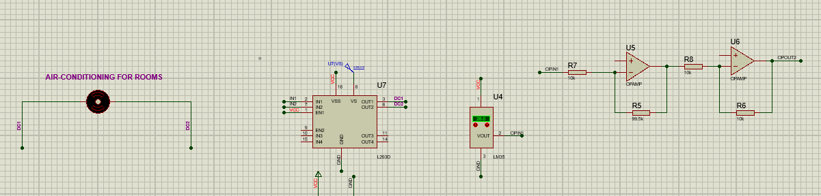
04
DC Motor | Tempreature control

Slide 18
DC Motor | Function
Measures The Tempreature
If The Tempreature is > 28 ֯C The Air conditoner turns on“DC Motor“
If The Tempreature is < 21 ֯C The Air conditoner turns off“DC Motor

Slide 19
DC motor | Problems
Sensing The Temperature
Sending The Temperature to motor
Turning The motor ON/OFF

Slide 20
DC Motor| Problem solving
Using PWM in Timer 2
Using LM35 Temperature sensor
Choosing timer 2 pins and ADC pins to control the motor “ON/OFF Situation” when its necessary

Slide 21
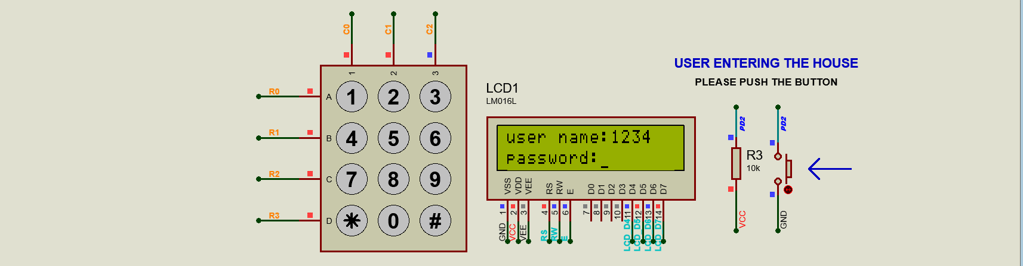
05
LCD & KEYPAD|emergancy case

Slide 22
LCD & Keypad | Function
To control the system via keypad and LCD at emergancy cases(every thing except the door)
LCD shows each device working (including tempreture of the room)

Slide 23
LCD & Keypad | Problems
Polling in case of the writing the code in main
Connections of KEYPAD
Limitation of the words that can fit the LCD

Slide 24
LCD & Keypad| Problem Solving
Using external interrupt to avoid polling
Choosing pins far from timer pins ,ADC… that are in sequence to avoid the logical error

